Slide 1


paycard program
October 2023

Slide 2


paycard program benefits
The PayCard Program is designed to facilitate compensation or reimbursements that departments may need to make, such as for clinical trial participants. It also, reduces or eliminates the need for petty cash or paper checks
U.S. Bank provides two types of pre-paid cards to the University:
        The Focus Card is reloadable, must be registered to a specific participant, and provides cash access
The Rewards Card is not reloadable, provides for cardholder anonymity, and does not provide access to cash

Slide 3

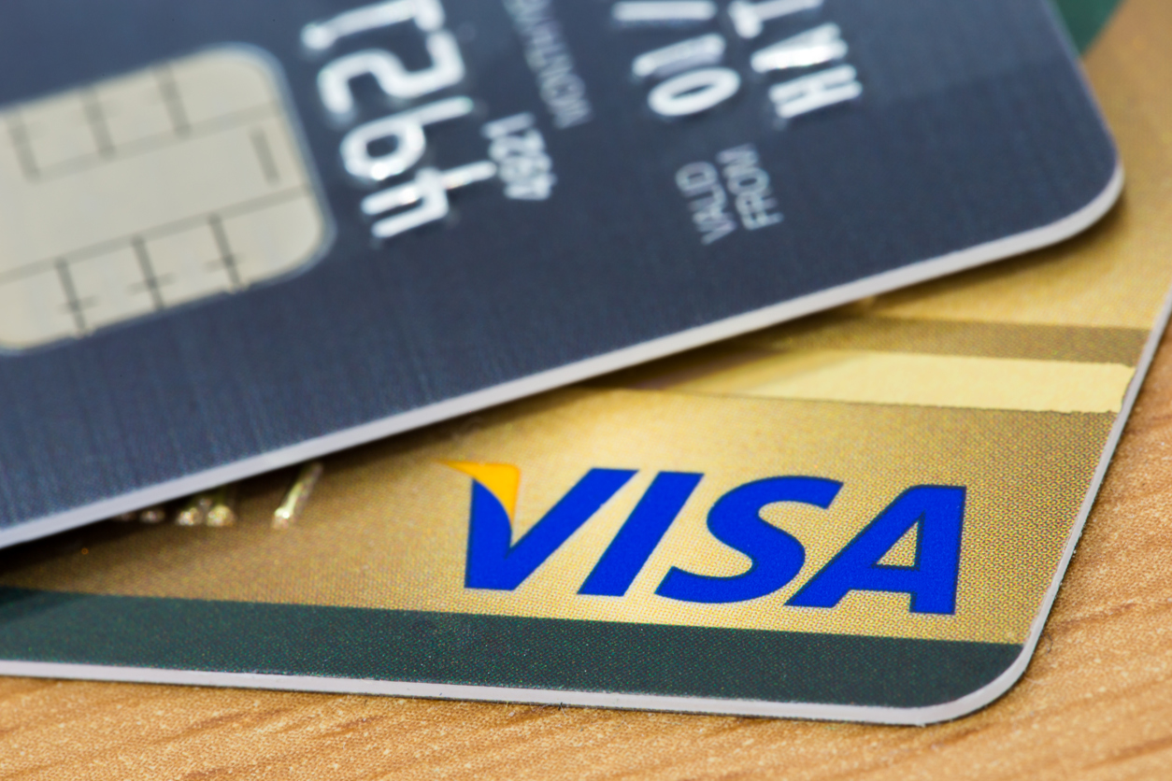
paycard program
(How it works)
Departments complete and submit the ServiceNow request form to the P-Card Team to order card inventory for delivery and provide a chartstring to allocate any per-card fees.
Departments submit Card Reconciliation, Card Inventory, and Card Funding Request Forms to the P-Card Team and initiate an AP Voucher in ARC to account for the expense and bank funding activity.
The P-Card Team uses U.S. Bank’s systems to order card stock and fund the cards.

Slide 4
U.S. Bank Card Focus vs. Rewards Comparison
Focus (Reloadable)
Rewards (Non-reloadable)
Anonymous: No
Cash Access: Yes
International Usage: Yes
MAX Load limit: $600
MIN Load Limit: $1
Reloadable: Yes
Card Expiration: 36 Months
Multiple Cards Per Participant: Yes
Pre-loadable At Time Of Order: No
Per Card Cost: No Cost
Card Replacement Cost: 1 Free Per Year
Card Holder Registration Required: Yes
*Card Activation Required: Yes
*Focus activate with 16-digit card #, CVV2 Code, and Zip Code
Anonymous: Yes (e.g., clinical studies)
Cash Access: No
International Usage: Yes
MAX Load limit: $600
MIN Load Limit: $10
Reloadable: No
Card Expiration: 24 Months
Multiple Cards Per Participant: Yes
Pre-loadable At Time Of Order: Yes
Per Card Cost: $1.50
Card Replacement Cost: $15.00
Card Holder Registration Required: No
*Card Activation Required: Yes
*Rewards activate with 16-digit card # and CVV2 Code

Slide 5
PayCard Inventory Order Process
Step 1 Department
Initiates and approves a request for card inventory via a Service Now Procurement Request PayCard Program
Rewards and Focus Blue card types available. Provide the number of cards to order.
  Focus Blue – A chartstring is not required, since these cards do not cost ($)
  Rewards - A valid chartstring will be required at a cost of $1.50 per card. The cards fees are allocated to the Department chartstring at the time the cards are ordered. All cards are paid in advance of the funding and are NOT REFUNDABLE. (Note: The ServiceNow chartstring can be designated as SPONS or GENRL, since they are billed at the time of order.)
Provide Inventory “ship to” location/address in the Comments Section on the ServiceNow
Attach Reconcile Inventory sheet to validate the number of cards with Department. This will be validated with the bank status. (This step is not required on the first inventory order request)
Step 2 PayCard Team
Review order and validate inventory details with bank status.
Order card inventory via the USBank system
Step 3 U.S. Bank
Process the card inventory order and
Forward cards directly to the designated Department address on file
Step 4 PayCard Team
Sends inventory order confirmation email to all parties. This email will contain the inventory Card IDs included in the card order.
Closes the inventory request form in ServiceNow
Process Journal to allocated the Card Fees to the Department chartstring noted on the ServiceNow inventory request.
Step 5 Department
Validates inventory received from the bank to verify accurate with ServiceNow. Notify PayCard team if Inventory is not received within 7-10 business days.
Notes:
Quick Reference

Slide 6
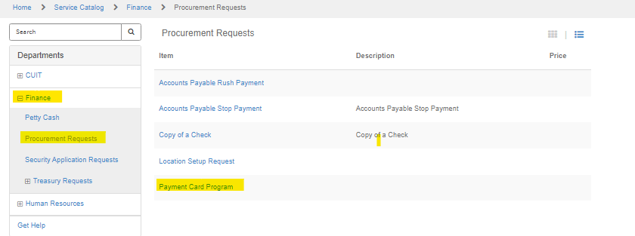
Service now paycard order form

Slide 7
INVENTORY sheet
FIELDS | DESCRIPTION
IRB Protocol # | IRB Protocol # for which the card will be used.
Date of Inv. Request | Date Payment Card Request Entered in Service Now
Inventory Order # | This will be provided by the paycardteam.
Card Type | Please select Rewards or Focus Card (Required in PayCard Load Form)
Customer ID (ATTMID) | Unique Identifier for each card type. This identifier is listed on the Rewards card window envelope
Card ID Number | Unique identifier (Required in PayCard Load Form)
Patient ID | Can be used by the department at their discretion.
Expiration Date | This will be provided by the PayCard team.
Card Status | Card Status - can be changed by the department to track card status' through the process. Select from: Loaded/Undistributed, Loaded/Distributed, Stale/Damaged
Voucher # | When loading, the Voucher # of the loading request.
Card # in Voucher | # of the card in the voucher request. If 10 cards being loaded on 1 voucher, then please enter "10".
Load Amount | The amount of the load for each card. (Required in PayCard Load Form)
Original Load Date | The date the confirmation came from AP that the card(s) has/have been loaded.
Comments

Slide 8
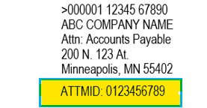
Verifying card order
DO NOT OPEN ENVELOPES!
Rewards Cards
Use the 10-digit ATTMID ID # highlighted below and also provided in the Inventory Reconciliation Sheet spreadsheet along with the Card ID#. The Card ID# on the inventory sheet will be used to populate the Funding requests.
The ATTMID in the below example is: 0123456789
Note: This Card ID# is also noted on the back of the card.

Slide 9

Verifying card order
DO NOT OPEN ENVELOPES!
Focus Cards
Use the 10-digit card ID # found in the window of each envelope. See example highlighted below. This card ID# is also provided in the Inventory Reconciliation spreadsheet provided by the PayCard team, so that you can validate the inventory shipment received is accurate.
The card ID in the below example is: 4762123414
Note: This Card ID# is also noted on the back of the card.

Slide 10
PayCard Funding/Load Process
Step 1 Department
Completes PayCard Load Form, which is the 3rd tab on the Master Inventory Template (Note: The Last 4 digits of each card will no longer be provided). The Card ID# provided on the Inventory confirmation sheet is also provided on the back of both Focus and Rewards cards.
Initiate and approve ARC voucher. (Vendor=PAYCARDUSB; Voucher Type=Pay Card, Location and Pay Method=Wire)
Upload the PayCard Load form to voucher. Supporting documents should include an approved load form and an excel format for uploading requirements.
Note: Maximum funding: $600 for Focus and Rewards. Minimum funding: $1 for Focus and $10 for Rewards
Step 2 A/P
Review voucher and documentation, places voucher on hold.
Emails PayCard team to Load from and approval to fund the cards.
Step 3 PayCard Team
Funds card via the US Bank Rewards and Focus systems.
Emails department and A/P once cards have been successfully loaded.
Releases voucher hold, expense is posted to the GL.
Step 5 Department
Distributes cards to subject study participants.
Updates/maintains Reconciliation sheet/control log of cards distributed and funded for reconciliation purposes.
Note: PayCards should only be funded as needed, the monies on the cards cannot be returned to the University.

Slide 11
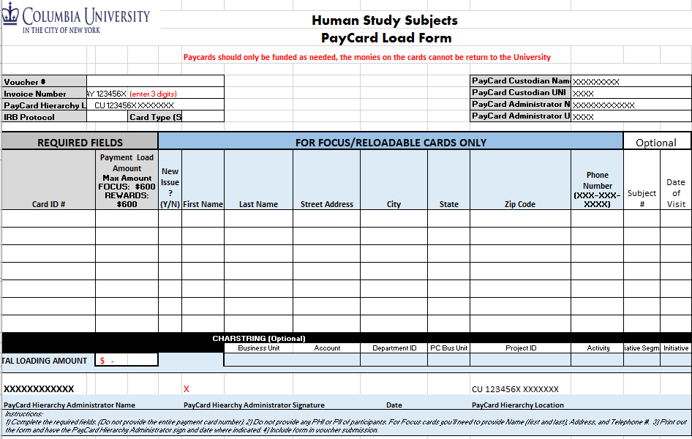
payCARD load form
Use the 10-digit Card ID # provided in your Payment Card Inventory Order request.
This number is also located on the back of each card.

Slide 12
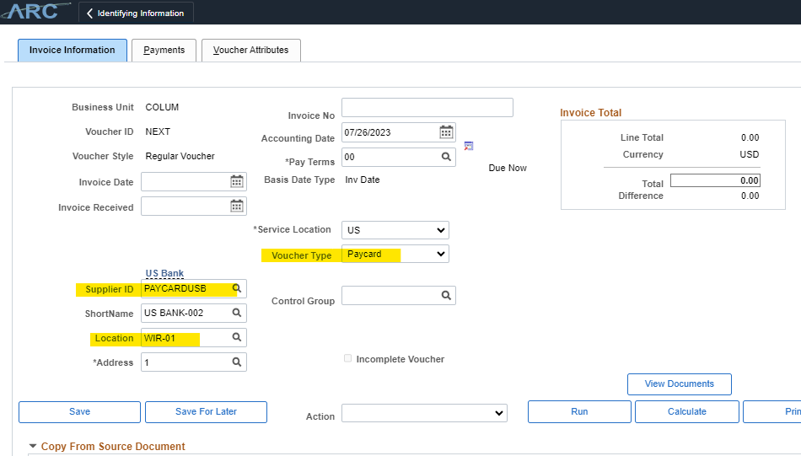
ARC Voucher Funding Request
Please enter the following
Invoice No:
PAY[Department Level]_###
Supplier ID::
PAYCARDUSB
Location:
WIRE-01
Voucher Type:
Paycard
Note: Be sure to note the voucher number on the PayCard Load Form.

Slide 13
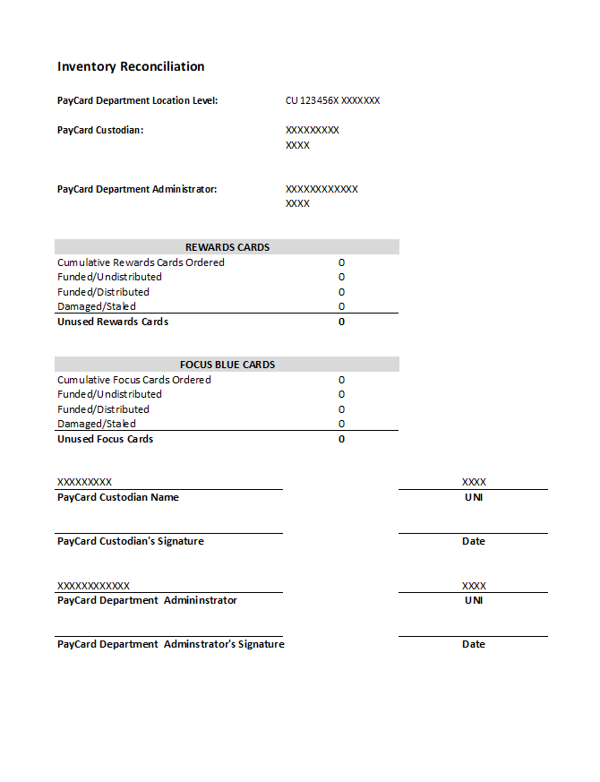
Reconcile inventory
Prior to issuing new cards, please email the following:
A signed and completed Inventory Reconciliation form
Backup for each card issued
Notes:
Update snapshot

Slide 14
PayCard Reminders
Only fund the cards when they will be needed. Do not fund cards in advance. Note: Once a card has been funded, we are unable to return the funds back to the University.
Rewards card cost is $1.50. The Rewards Card Fee is allocated to the chartstring details provided on the ServiceNow inventory request. The fees will be allocated to this chartstring at the time the card inventory is ordered.
The cards funding amounts are: Maximum funding for both Focus and Rewards is $600. Minimums funding amounts are $1 for Focus and $10 for Rewards
The Rewards card window envelope will include an ATTMID #, which will be provided on the Inventory order confirmation spreadsheet, along with the Card ID. This ATTMID number is linked to the Card ID which is required on the Funding Load form.
The Focus Card window envelope will provide the Card ID which the last 7 digits are used to populate the Funding Load form. The Card ID is the last 7 digits
PayCards should only be used for IRB approved compensation for study subject participants.
The Card# ID which is the unique card identifier, is also noted on the back of the physical card. The last 4 digits of the card are not required.
Be sure to monitor/track the Department Inventory, to prevent Expired Card funding. Note: Department should only have cards needed within the month to prevent Unused funded cards.
Audit requires that each card funding will need to be captured with a supporting document to Acknowledgement of receipt of funds - signed/initialed by the subject.
Always upload an excel Load form document with the AP Voucher support. If an excel is not included, the voucher will be returned.

Slide 15
PayCard Reminders (con’t)
Do not modify the PayCard Loading form format, except to add lines for additional funding. If the format of the load form is changed, we will return, to obtain the format as required for the bank upload.
A new load from should be created with every voucher request, we do not recommend re-using a load form
Focus Blue(Reloadable) cards should only be listed once on a PayCard Load form. Do not enter multiple loads for the same recipient on the same PayCard Load Form.
To improve efficiency, we recommend submitting one PayCard Load form per day, which includes all the card recipients and required funding.
Each Department create an alias email for PayCard, i.e., cudeptpaycards@columbia.edu. This will ensure that the email is provided to all departmental PayCard users within the Department.
Notes:
Add Point the $1.50 is charged at the point of Inventory order on the Service now request. Need to verify the Inventory and $1.50

Slide 16
Getting Help
For assistance with any questions about the PayCard :
Visit Columbia Finance PayCard page: https://www.finance.columbia.edu/content/purchase-using-pay-card-human-subjects
Email: paycardteam@columbia.edu
Or, visit the Finance Service Center at : https://www.finance.columbia.edu/content/finance-service-center

